Slide 1
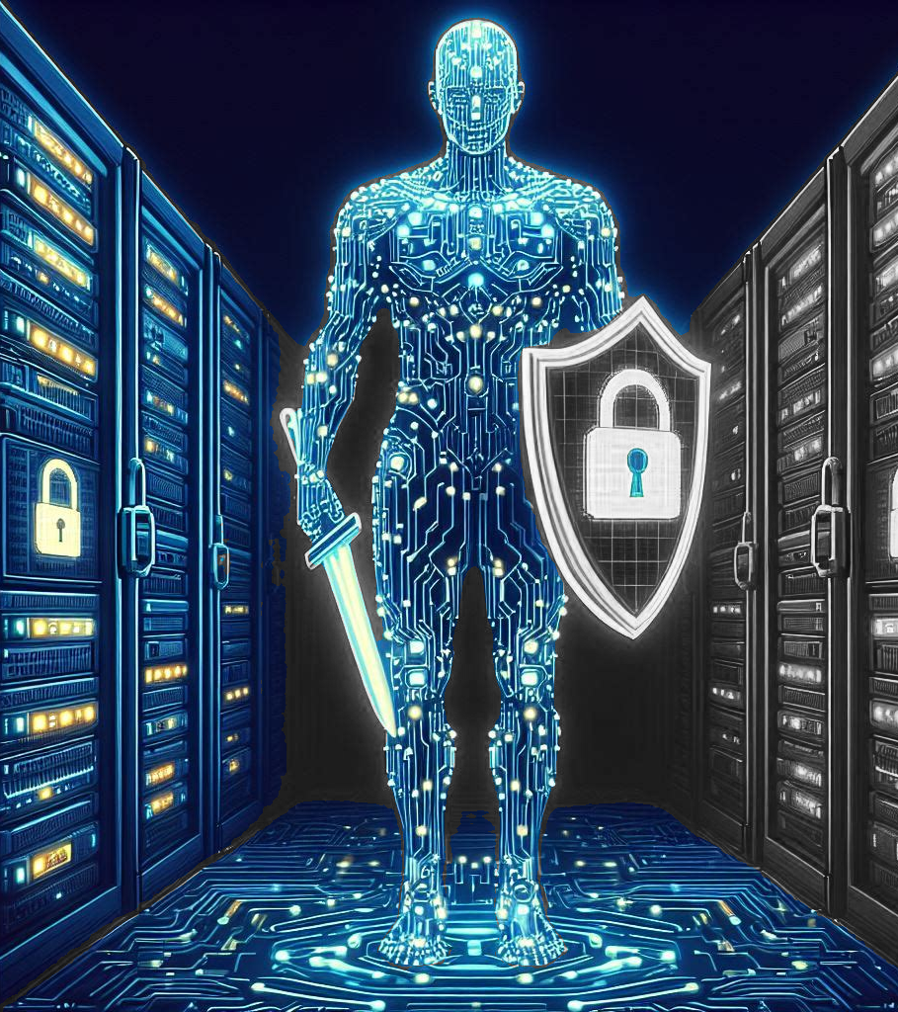
CyberGPT: Enhancing Cyber-threat Analysis using Generative-AI
AI for Business - Group 5
Akshit Ram Pershad
Haritha Karna
Joe Arul Susai Prakash
Shilpi Kumari
Notes:
Threats, As we all know, cyber threats are identified attacks or viruses that attempt to access personal data and systems illegally. These threats can originate from various sources, including nation-states, terrorist groups, individual hackers, or even trusted individuals like employees or contractors who abuse their privileges to perform malicious acts
Evaluating threats is crucial in today's rapidly evolving technological landscape While traditional threats like viruses, DOS, and phishing attacks persist, we are witnessing more sophisticated threats like advanced persistent threats (APTs), Black Swam, Zero-day attacks, etc In the same way technology has advanced significantly, from traditional computers to the rise of the internet and enhanced automated AI-driven systems, the cyber threat and technology landscape has evolved in parallel with challenges posed by the increasing number of cyber assets
For instance, the SolarWinds hack in 2020 highlighted the vulnerability of supply chain attacks. A nation-state actor was able to compromise SolarWinds' software update system, allowing them to infiltrate numerous government agencies and private companies, demonstrating the far-reaching consequences of such attacks.

Slide 2
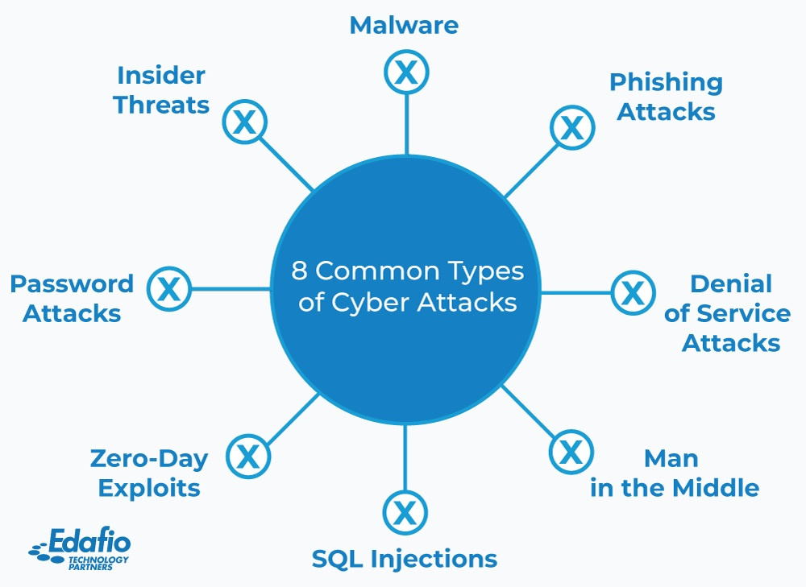
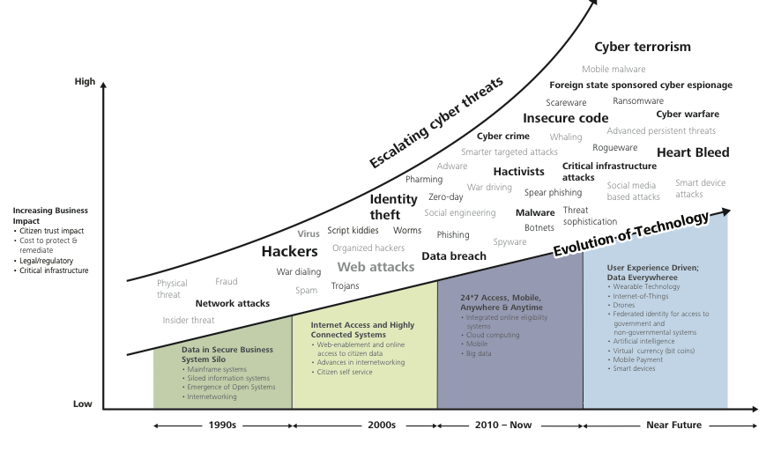
Background and Motivation
Cyber Threat Overview
Evolving Threat Landscape
Technology Advancement
Unification of technologies

Slide 3
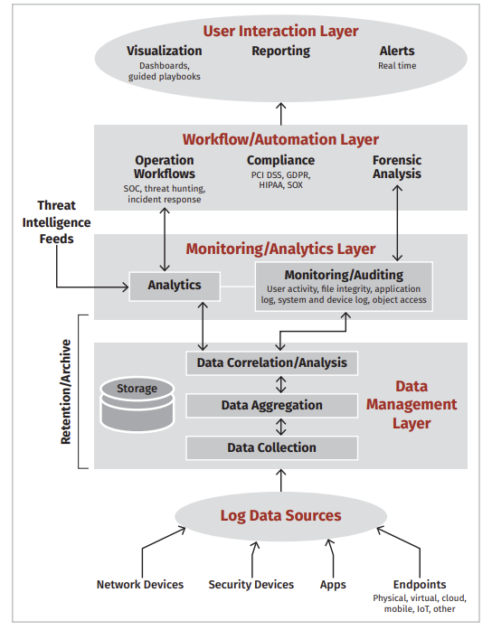
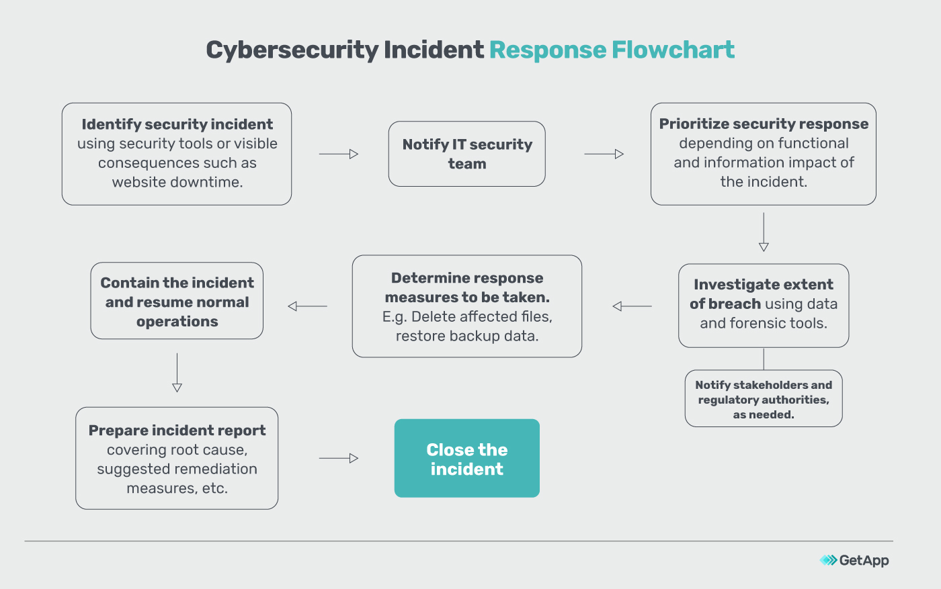
THREAT DETECTION-ANALYSIS-RESPONSE PROCESS (PROBLEM SPACE)

Slide 4
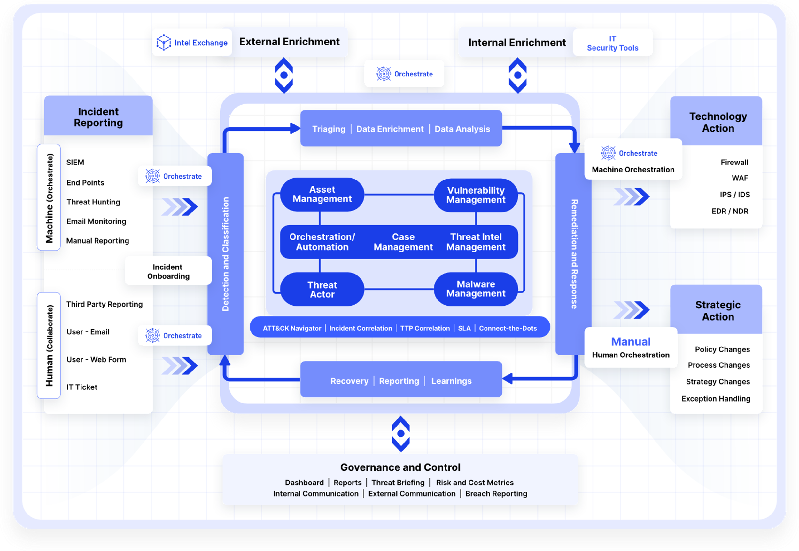

CURRENT STATE OF THREAT INTELLIGENCE (PROB. SPACE)

Slide 5
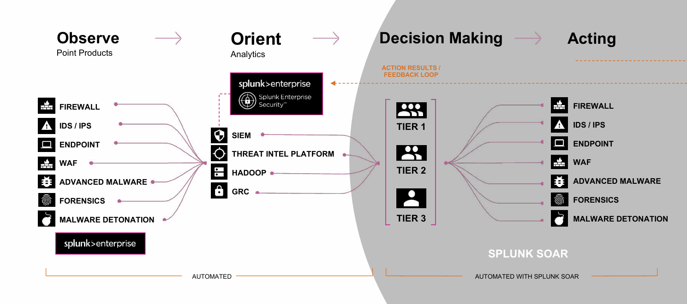

UNIFIED SECOPS CASE STUDIES (PROBLEM SPACE) SPLUNK MISSION CONTROL, MICROSOFT SENTINEL, IBM QRADAR

Slide 6
CyberGPT Machine Design (Solution Space)

Slide 7
Human Behavior Design
Our chat interface, powered by generative AI and fine-tuning models, enables cyber analysts to engage with an AI solution, enhancing understanding and responsiveness to cybersecurity queries and threats.
The AI leverages historical incident data, organizational architecture insights, and open threat intelligence databases to analyze, suggested response playbooks and respond to emerging threats effectively.
Benefits for Cyber Analysts:
Empowers analysts with comprehensive historical insights and real-time threat intelligence.
Streamlines threat analysis and resolution processes.
Enhances collaboration and decision-making within cybersecurity teams.
The interface prioritizes simplicity and user-friendliness, facilitating easy navigation, interaction, and access to essential functionalities such as inputting threat details, viewing historical data, and receiving recommendations.

Slide 8
Generative AI methods used in CyberGPT (Solution Space)
Pre-training / Fine-tuning of LLMs: Training a new model on Cyber data & Fine-tuning an existing model using techniques like PEFT and QLora help make the Gen-AI model more accurate in analyzing cybersecurity problems.
Retrieval Augmented Generation: Historical Incident Documentation, Open-Source Threat Intelligence and Threat Strategy data is vectorized and stored in vector databases like LlamaIndex to provide richer context to LLMs at the time of generation.
Prompting: The LLMs are continually prompted by the CyberGPT manager from different angles to obtain a detailed, well-thought response which helps SOC analysts take appropriate steps to combat the threat.

Slide 9
Requirements to build the solution (Implementation Cycle)
Component 1 – Past incident documentation and historical data : Unavailable
Component 2 – Open Threat Intelligence Repositories : Available, needs to be vectorized (Open Threat Exchange)
Component 3 – Threat Response Frameworks / Strategies : Available, needs to be vectorized (MITRE Attack)
Component 4 – Model trained on Cybersecurity datasets : Available (ZySec AI on Huggingface)
Component 5 – User Interface to access CyberGPT : Needs to be built
Organizational cybersecurity architecture : Unavailable

Slide 10
Implications of Generative AI in Cybersecurity Incident Response
Enhanced Threat Detection | Streamlined Incident Response | Addressing Black Swan Events
Generative AI can significantly improve threat detection by analyzing patterns and anomalies in data that might be missed by traditional methods. The integration of AI with XDR and SIEM tools can lead to earlier and more accurate detection of potential threats. | By automating the response process, SOAR tools augmented with AI can reduce the time between detection and response, minimizing potential damage. AI can assist in creating dynamic playbooks that adapt to new threats, ensuring a swift and appropriate response to incidents. | Generative AI can help in understanding and responding to ‘black swan’ incidents by providing recommendations based on similar historical events and patterns. This reduces the reliance on manual scouring of documentation and consultation, leading to faster resolution times
Cost Reduction | Continuous learning and Improvement | Ethical privacy considerations
Faster incident response and resolution can significantly reduce the financial impact of cyber-attacks. AI-driven automation can also decrease the workload on cybersecurity analysts, allowing them to focus on more complex tasks. | Generative AI systems can learn from each incident, improving their recommendations and responses over time. This leads to a continuously evolving cybersecurity posture that can adapt to the ever-changing threat landscape. | Implementing AI in cybersecurity must be done with consideration for ethical issues and privacy concerns. Ensuring that AI systems are transparent and accountable is crucial for maintaining trust and compliance.

Slide 11
Thank You!
References
Background:
Cyber-evolution: https://www.researchgate.net/publication/374156044_Evolution_of_the_Cyber_Security_Threat_An_Overview_of_the_Scale_of_Cyber_Threat
Threat D&R to Intelligence: https://blogs.idc.com/2023/08/24/evolving-from-threat-detection-and-response-to-threat-intelligence/
Problem Space:
AI/ML in Security Automation: https://www.techscience.com/iasc/v28n2/42057/html
SIEM to SOAR: https://correlatedsecurity.com/soar-critical-success-factors/
Next-generation SIEM systems: https://www.sans.org/media/vendor/evaluator-039-s-guide-nextgen-siem-38720.pdf
MITRE attack framework: https://www.recordedfuture.com/threat-intelligence-101/tools-and-technologies/mitre-attack-framework
Case Studies:
Microsoft Sentinel: https://learn.microsoft.com/en-us/azure/sentinel/
Splunk Mission Control: https://www.splunk.com/en_us/products/mission-control.html
Cyware Platform: https://cyware.com/products/incident-analysis-threat-response-platform

